Slide 2
Oracle Visual Builder Cloud Service Overview
Presenter Info
Notes:
This is a Title Slide with Picture slide ideal for including a picture with a brief title, subtitle and presenter information.
To customize this slide with your own picture:
Right-click the slide area and choose Format Background from the pop-up menu. From the Fill menu, click Picture and texture fill. Under Insert from: click File. Locate your new picture and click Insert.
To copy the Customized Background from Another Presentation on PC
Click New Slide from the Home tab's Slides group and select Reuse Slides.
Click Browse in the Reuse Slides panel and select Browse Files. Double-click the PowerPoint presentation that contains the background you wish to copy.
Check Keep Source Formatting and click the slide that contains the background you want.
Click the left-hand slide preview to which you wish to apply the new master layout.
Apply New Layout (Important): Right-click any selected slide, point to Layout, and click the slide containing the desired layout from the layout gallery.
Delete any unwanted slides or duplicates.
To copy the Customized Background from Another Presentation on Mac
Click New Slide from the Home tab's Slides group and select Insert Slides from Other Presentation…
Navigate to the PowerPoint presentation file that contains the background you wish to copy. Double-click or press Insert. This prompts the Slide Finder dialogue box.
Make sure Keep design of original slides is unchecked and click the slide(s) that contains the background you want. Hold Shift key to select multiple slides.
Click the left-hand slide preview to which you wish to apply the new master layout.
Apply New Layout (Important): Click Layout from the Home tab's Slides group, and click the slide containing the desired layout from the layout gallery.
Delete any unwanted slides or duplicates.

Slide 3
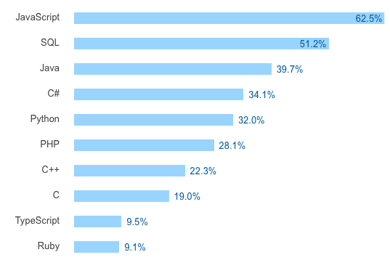
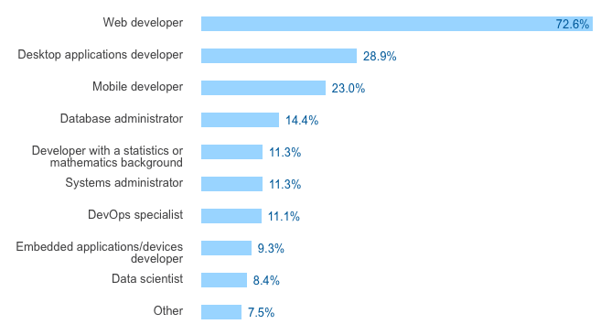
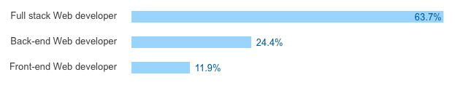

The Rise of JavaScript

Slide 4
Why are JavaScript/HTML5/REST So Popular
Better UI experience
Easier adoptability to mobile
Web and on-device with same stack
Scalable
Decoupled
“Cool”

Slide 5












So Many Choices

Slide 6

What’s The Problem?

Slide 7
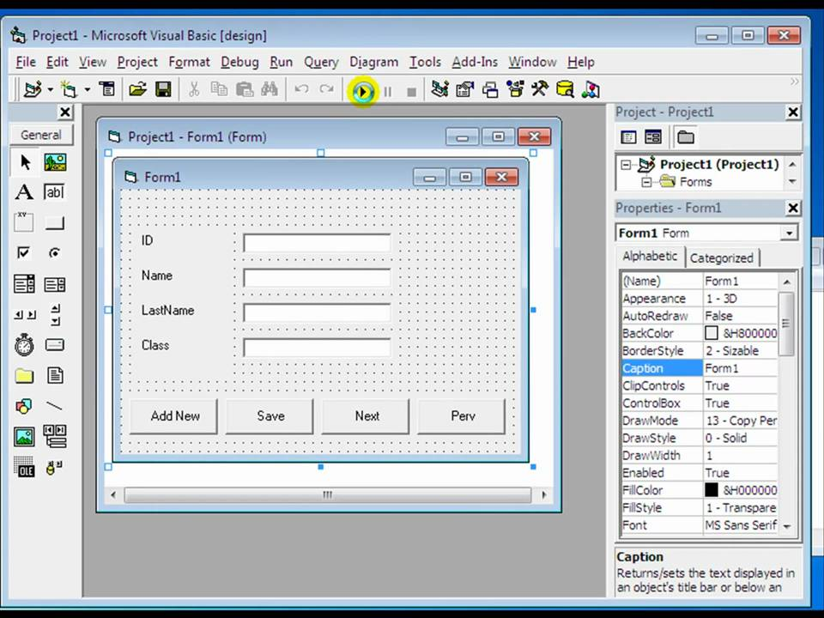
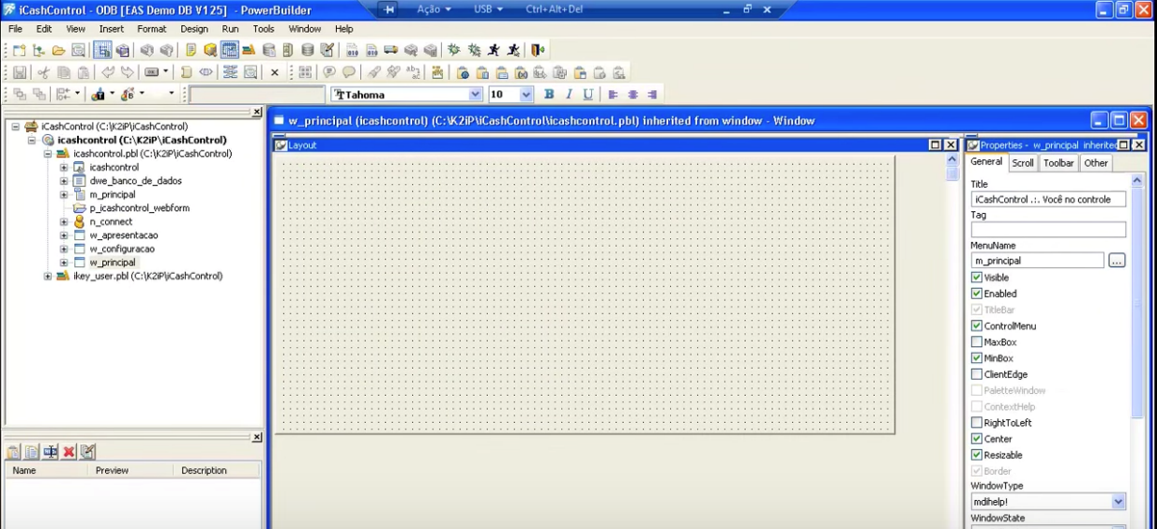
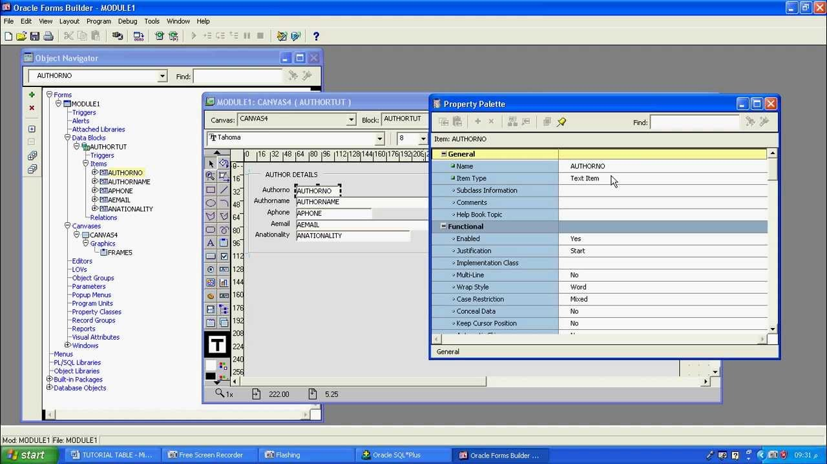
Is Development Productivity Regressing?

Slide 8

It’s Time for Visual Dev Tools for JavaScript/HTML/REST
Low-code platforms
The new name for RAD tools
Bringing development with new technologies to a boarder audience
Focuses on Business Applications

Slide 9

But I Rather Code – Is This Still Relevant For Me?
YES
Quick mockups
Create prototype
Get customer feedback
Base for application
Create the basics visually
Extend with code
A tool for your business users to extend applications you wrote

Slide 10

Oracle Visual Builder Cloud Service
Build and host web and mobile applications in a faster and simpler way with zero install and visual development experience

Slide 11




Our Technology Stack and Architecture
UI – Oracle JET
Backend – REST Services
Database – Oracle
Web Applications
Mobile Applications
Builder
UI Components
Business Objects
Local DB Services
Third Party Services

Slide 12

Oracle JET
A modular, enterprise-ready, open-sourced toolkit that simplifies development with a JavaScript/HTML5/REST stack

Slide 13

Oracle JET - Value Proposition
Enterprise ready - built-in accessibility, security, internationalization
Rich components set - including data visualization
Advance routing - for single page applications
Common model – for simplified data binding with web services
Built-in responsive UI - at both the CSS and JS level
Based on Open-Source - leverage existing skills and community knowledge
Modular architecture – use what you need, lightweight and fast
Optimized for Oracle customers – Supports Oracle Alta UI and Oracle REST
13

Slide 14





Oracle JET – Open Source Libraries
Two way data binding
Widget Factory
Knockout.js
jQueryUI
DOM manipulation + Ajax
Resource Management
jQuery
RequireJS
Touch Gesture Support
Hammer
14

Slide 15


Oracle JET Architecture
JET UI Components
JQueryUI
Hammer
SASS
View
JET Routing System
Require.JS
Knockout.JS
ViewModel
JET Common Model
Model
Client Browser
Server Side
REST
WebSocket
Business Services
Data

Slide 16
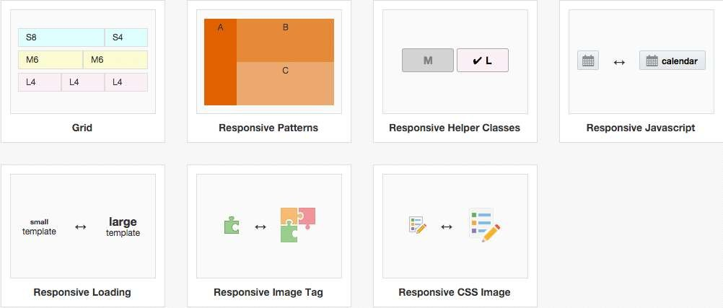
Grid and Responsive

Slide 17

Visual Builder Cloud Service
Key principles for Visual Builder
Cloud Based
Nothing to install or configure, runs in the browser. Applications accessible from any device.
Easy to Use
Drag and drop visual development with live WYSIWYG designer
SaaS Integrated
Easy access to SaaS data and processes via REST catalog. Enrich SaaS with engaging custom UI.
Extensible
More complex behavior can be implemented in standard JavaScript and HTML.

Slide 18











Oracle Visual Builder Cloud Service Architecture
Processes
Oracle SaaS
PCS
HTTP / REST
Business Objects
Oracle JET
VBCS
Runtime &
App Hosting
Data
DBCS
Other REST

Slide 19
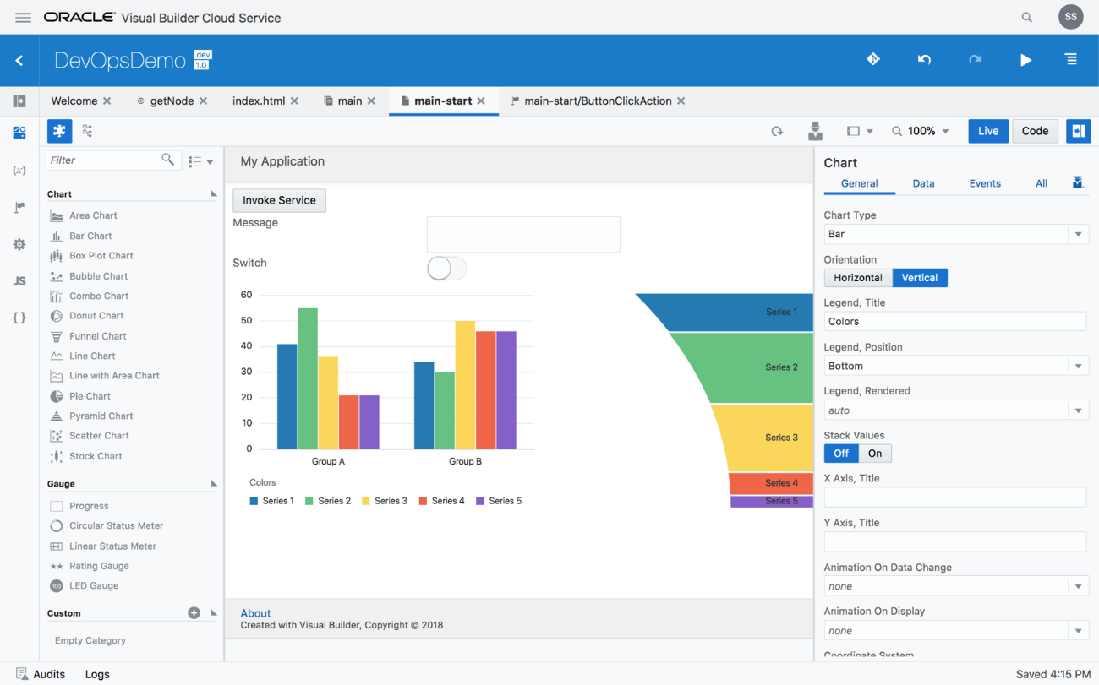
Simple UI Development
Oracle JET 5 UI
Component Palette
Add Additional Web Components
Drag and Drop
WYSIWYG
Property inspector
Multi-device live preview
Security role preview

Slide 20
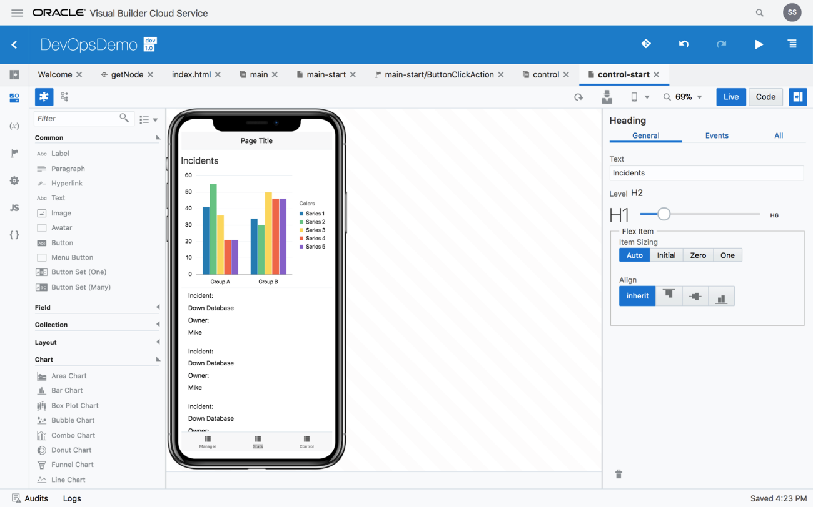
On-Device Mobile Applications
Unified development experience
Native look and feel for iOS and Android
Preview on device emulators
Application installs and runs on device

Slide 21
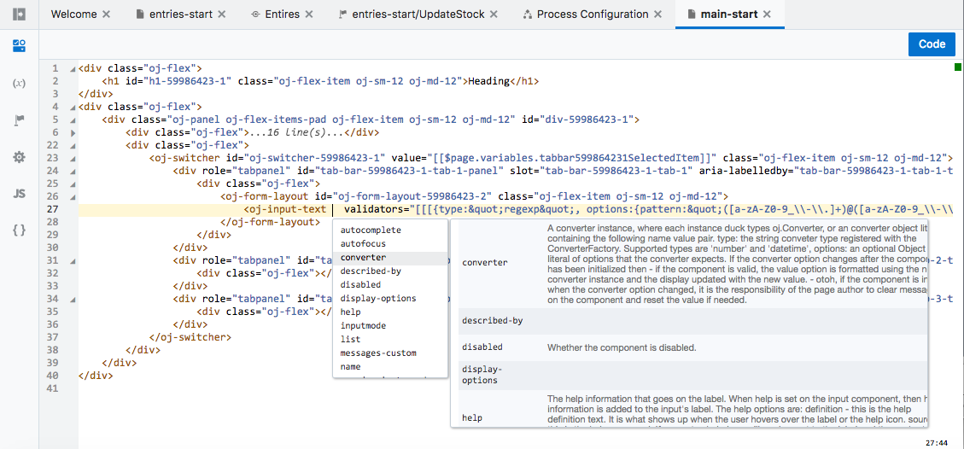
Two Way UI Editing – Direct Code Access
Rich code editor
Syntax highlighting
Code insight
Popup doc
Formatting
Code collapse
Smart rename

Slide 22
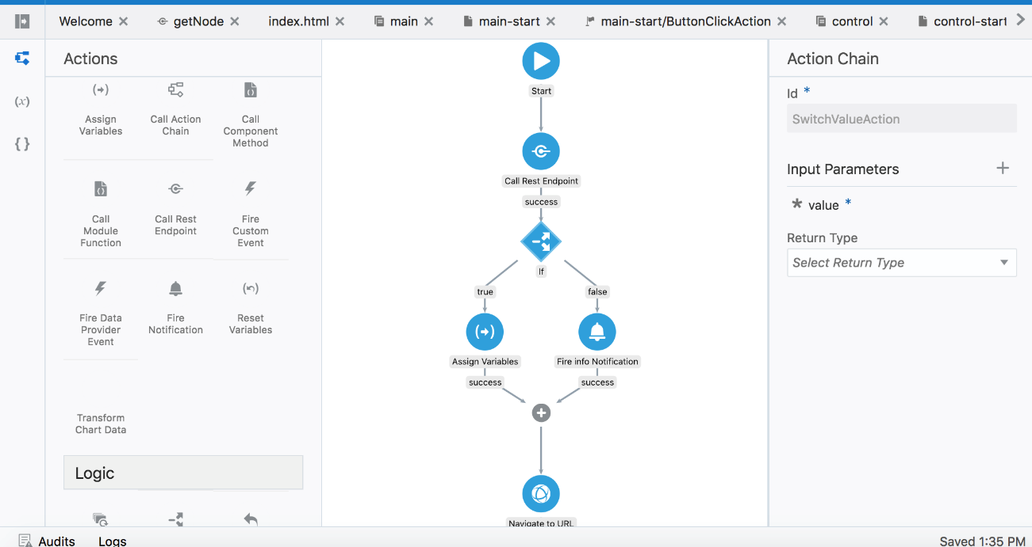
Custom Logic
Visually define Action Flows
Built in functions
Custom actions
JavaScript
Create reusable action flows

Slide 23
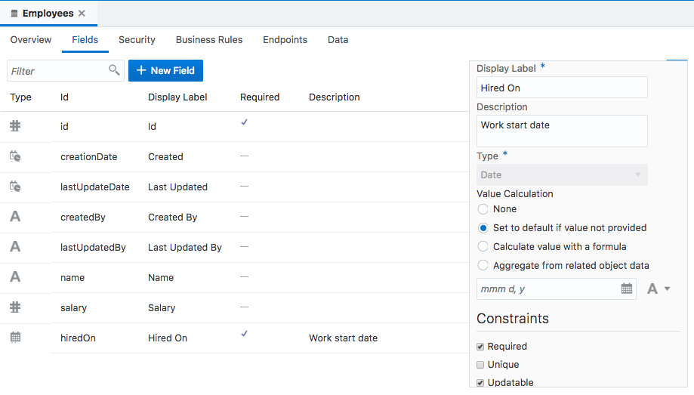
Create Your Own Data Objects
Declarative definition
Import from spreadsheets
Multiple field types
Relationships establishment
Declarative aggregated fields
Data stored in an Oracle cloud database
Access through REST

Slide 24
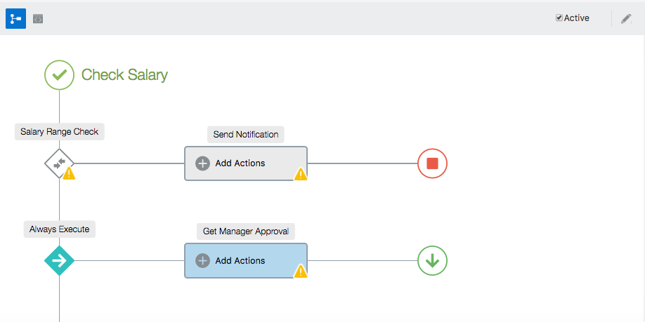
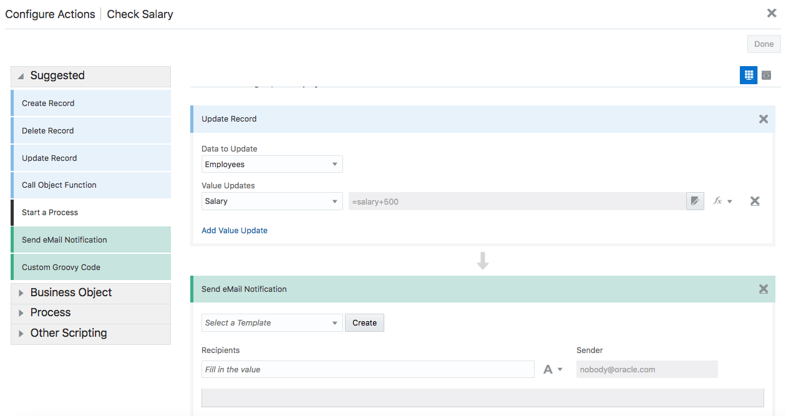
Business Object Business Logic
Define triggers, object validators, field validators and object functions
Server side execution
Visual logic flow
Declarative conditioning
Groovy scripting for advanced logic needs

Slide 25
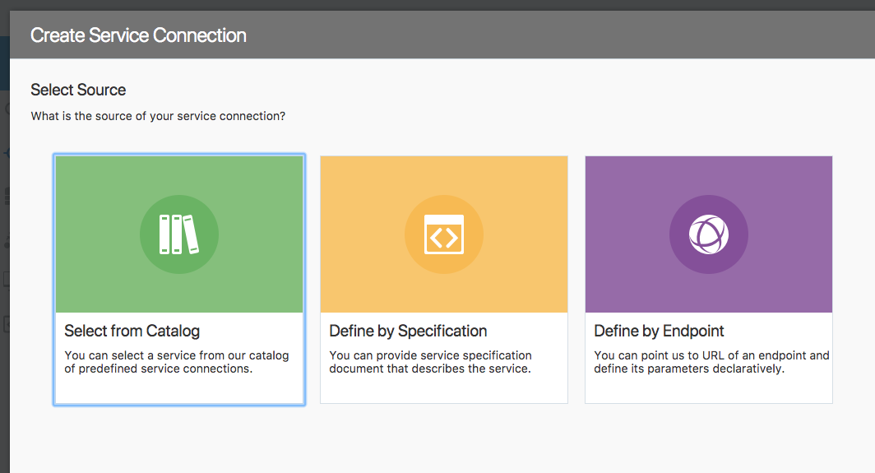
Consume REST Services
REST services catalog
Pre-populated with Oracle cloud services
Add other services

Slide 26
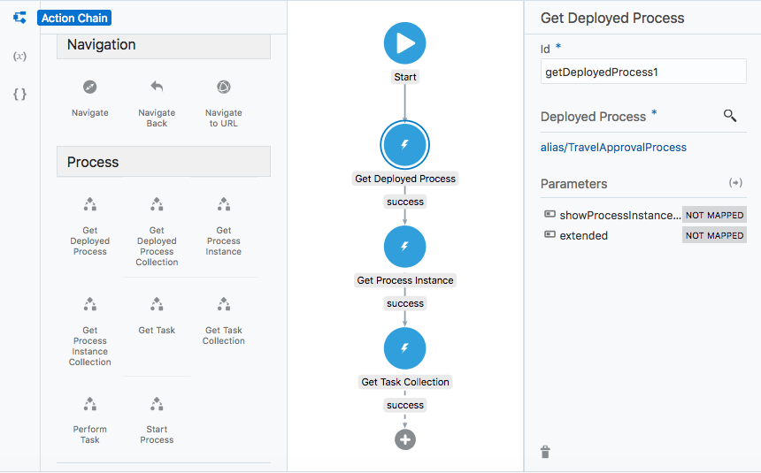
Process Integration
Built-in integration with Oracle Process Cloud
Add processes into your application
Action flows command to interact with processes in a declarative way
Direct access to data from business objects in the process

Slide 27
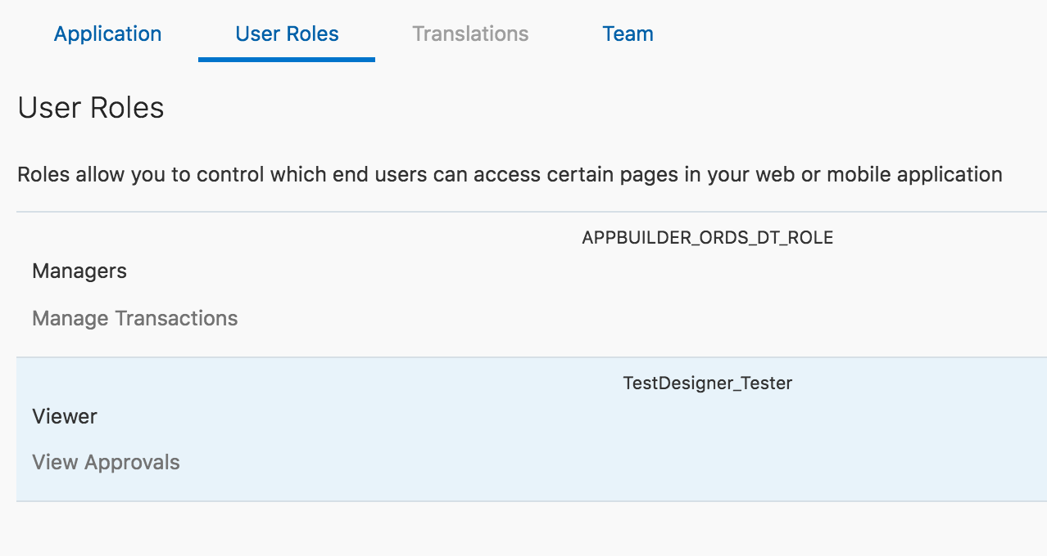
Security
Anonymous or Authentication
Role based security
Declarative security on business objects (row value level)
Access user/role in code and UI for programmatic control

Slide 28
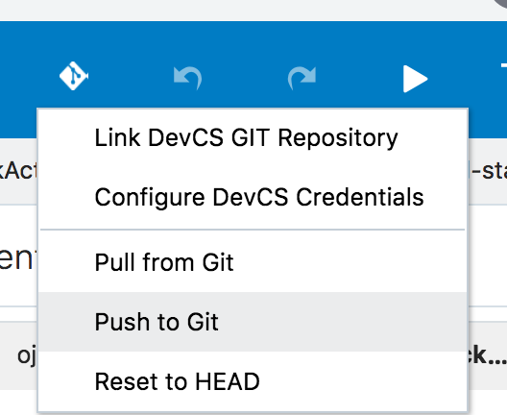
Team Collaboration
Multi-developer support
Git based versioning
Integration with Developer Cloud Service

Slide 29
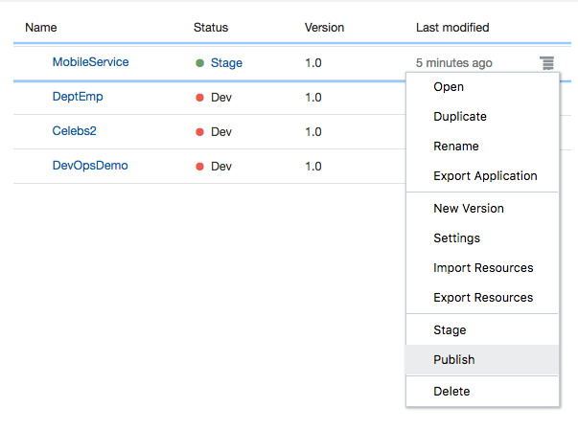
Publish
Develop/stage/publish
One click publish
Automatic hosting
Shareable URL
Public or private
Role based
Export app to other instances

Slide 30
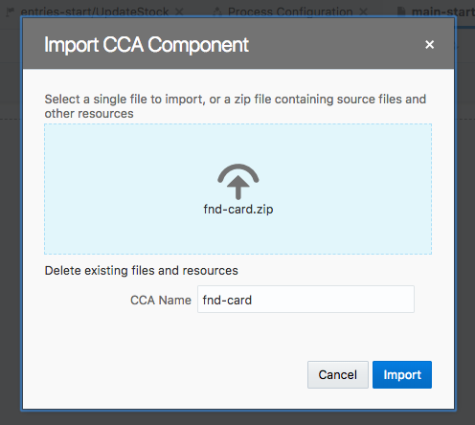
Extendable Platform
Add UI components
Add JavaScript code
Add Look and feel

Slide 31
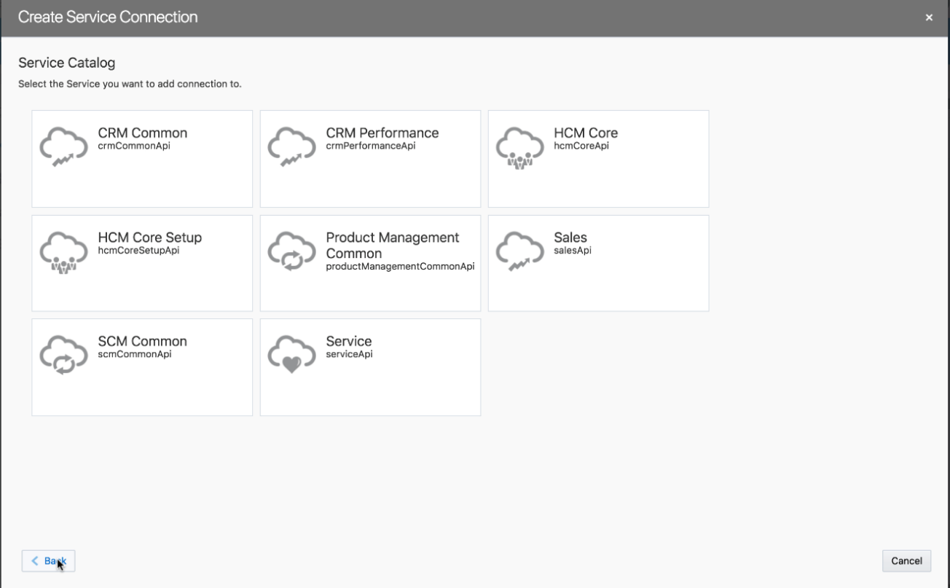
Oracle SaaS Extensions
Pre-populated Service Catalog
Single-sign-on

Slide 32
Autonomous Features
Eliminates installation and maintenance of development platforms
Eliminates installation and maintenance of deployment platform
Automates delivery of mobile applications across multiple platforms
Automates code generation & single button deployment

